Slide 1
Report on Diwali Sales Analysis
Prepared by Shakil Ahammed

Slide 2
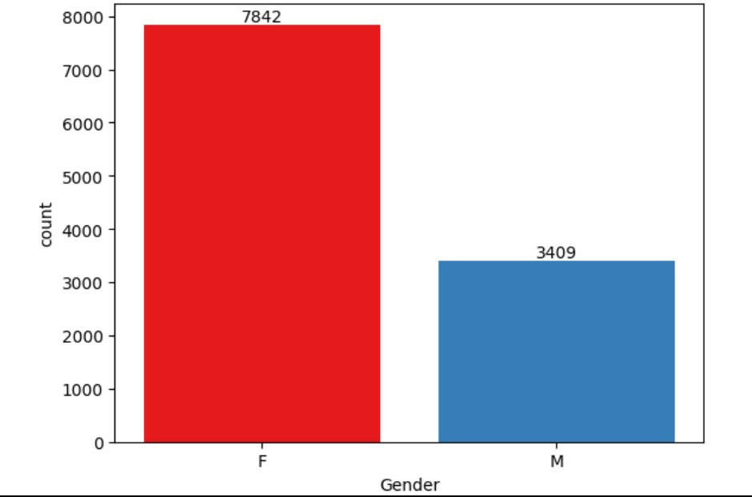
Most of the buyers are females.

Slide 3
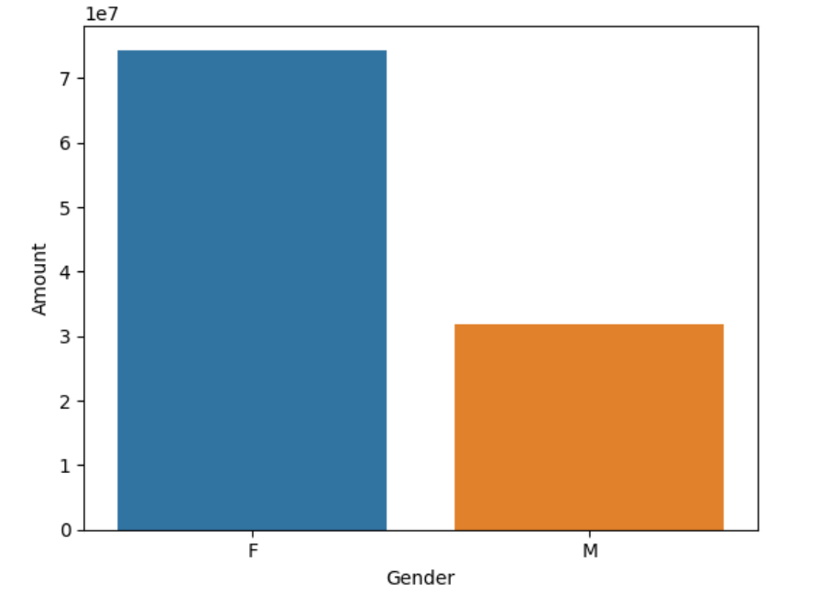
The purchasing power of females are greater than men.

Slide 4
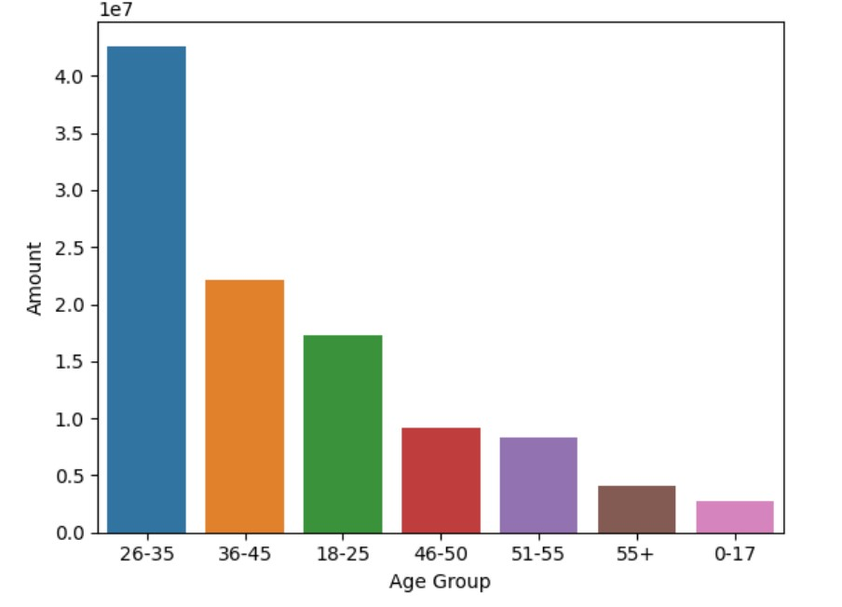
Most of the buyers are of age group between 26-35 years female.

Slide 5
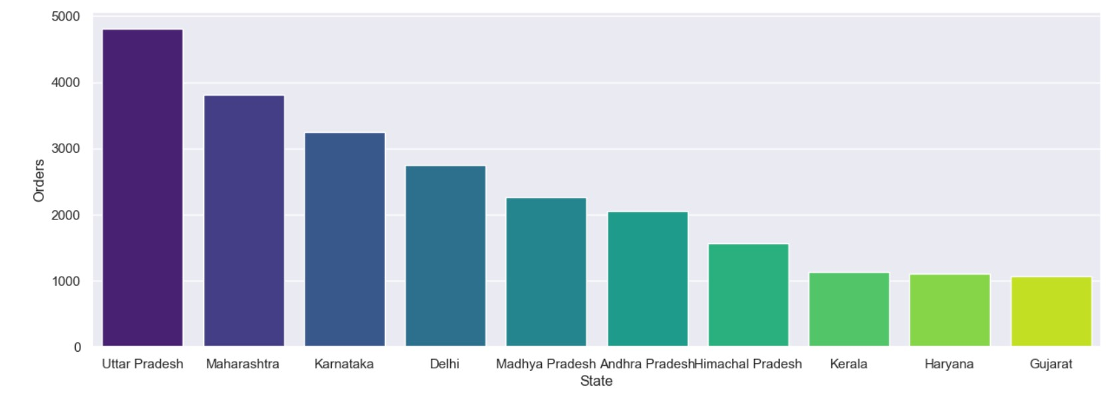
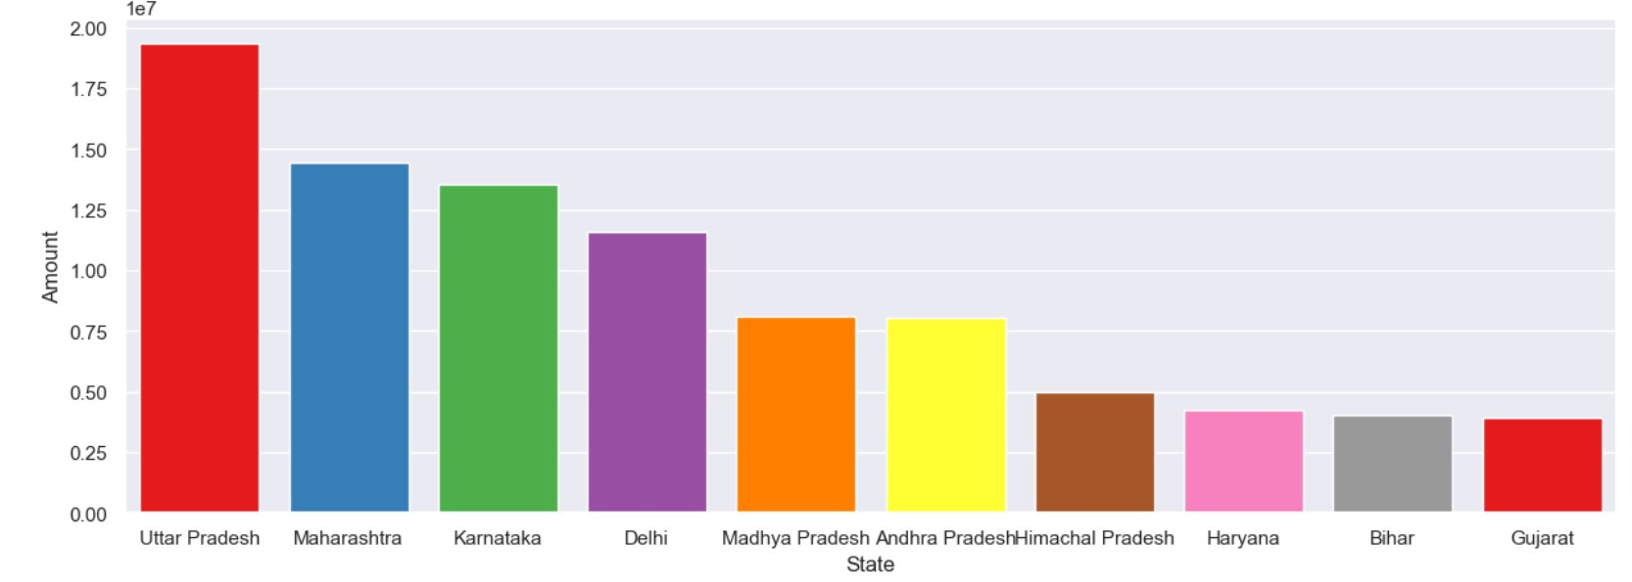
Most of the orders & total sales/amount are from Uttar Pradesh, Maharashtra, Karnataka.

Slide 6
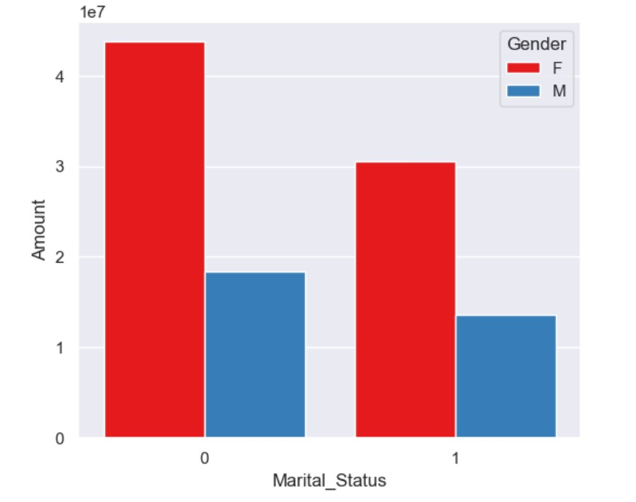
Most of the buyers are married (women) and they have high purchasing power.

Slide 7
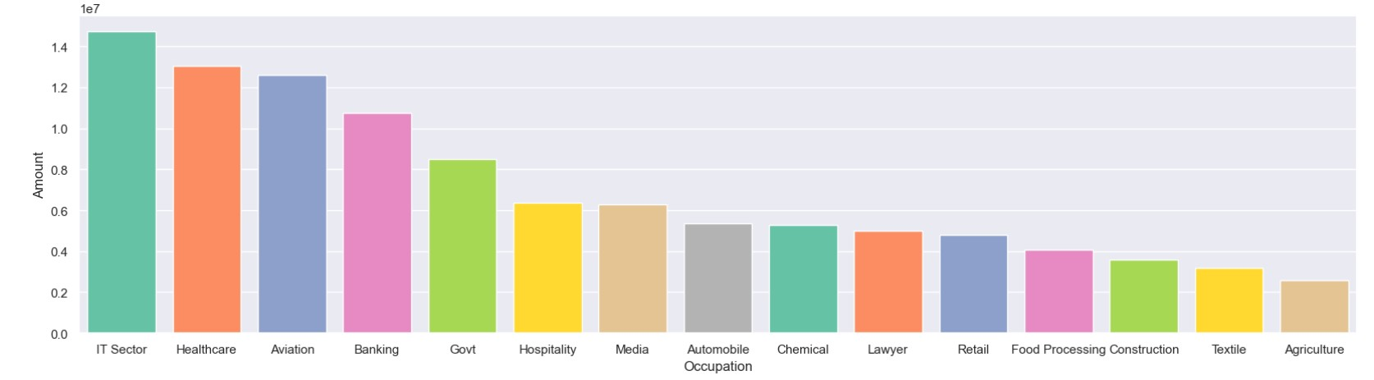
Most of the buyers are working in IT, Healthcare and Aviation sector.

Slide 8
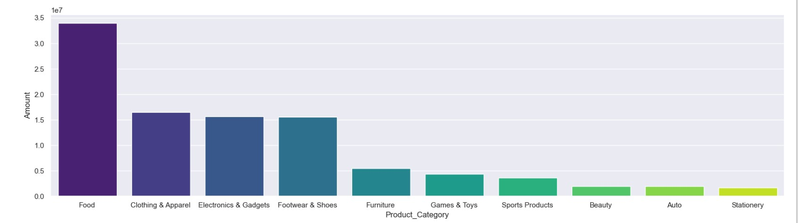
Most of the sold products are from Food, Clothing and Electronics category.

Slide 9
Conclusion
Married women age group 26-35 years from Uttar Pradesh, Maharastra and Karnataka working in IT, Healthcare and Aviation are more likely to buy products from Food, Clothing and Electronics category.

Slide 10
Recommendation
1. Targeted Marketing Campaigns: Develop targeted marketing campaigns specifically tailored to the preferences and needs of married women aged 26-35 working in IT, Healthcare, and Aviation sectors in Uttar Pradesh, Maharashtra, and Karnataka. Highlighting products from these campaigns' Food, Clothing, and Electronics categories can enhance engagement and conversion rates.
2. Regional Customization: Recognize and accommodate regional preferences and cultural nuances variations within Uttar Pradesh, Maharashtra, and Karnataka. Customize marketing messages and product offerings to resonate with the specific tastes and lifestyle choices of the target demographic in each state.

Slide 11
3. Online Presence Enhancement:
Given the focus on IT, consider strengthening the online presence of products in the Food, Clothing, and Electronics categories. Optimize e-commerce platforms, leverage social media channels, and explore digital marketing strategies to effectively reach and engage the target audience.
4. Customer Feedback and Engagement: Actively seek and respond to customer feedback to understand evolving preferences and trends. Establishing a feedback loop can contribute to the ongoing refinement of products and marketing strategies, ensuring sustained appeal to the target demographic.

